Slide 1
Recipients’ Meeting
August 29, 2017
Annaliese Mayette, Drug Epidemiologist

Slide 2
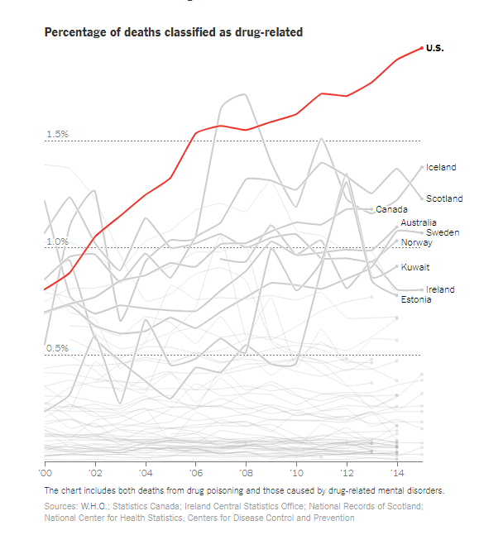
Source: NY Times, Short Answers to Hard Questions About the Opioid Crisis, August 3, 2017 (retrieved on 4 august, 2017 from https://www.nytimes.com/interactive/2017/08/03/upshot/opioid-drug-overdose-epidemic.html)
The US rate was ‘roughly 2 percent’ in 2015

Slide 3
“Overdoses killed more people last year than guns or car accidents, and are doing so at a pace faster than the H.I.V. epidemic at its peak. In 2015, roughly 2 percent of deaths — one in 50 — in the United States were drug-related.”
Source: NY Times, Short Answers to Hard Questions About the Opioid Crisis, August 3, 2017 (retrieved on 4 august, 2017 from https://www.nytimes.com/interactive/2017/08/03/upshot/opioid-drug-overdose-epidemic.html)

Slide 4
Drug Overdose Death Rates Leading States, U.S., 2015
Rank State Deaths per 100,000
1 West Virginia 41.5
2 New Hampshire 34.3
3 Kentucky 29.9
4 Ohio 29.9
5 Rhode Island 28.2
6 Pennsylvania 26.3
7 Massachusetts 25.7
8 New Mexico 25.3
U.S. 16.3
Sources: CDC Wonder
Rates are age-adjusted to the 2000 US Standard Population.
Source: http://www.cdc.gov/mmwr/preview/mmwrhtml/mm6043a4.htm?s_cid=mm6043a4_w
NOTE: The published results in the 11/11 MMWR don’t quite tie to CDC Wonder (e.g., drug_OD_deaths, by COD and state, US, 1999-2008, v 1.0.xlsx -or- slide 5 source)

Slide 6
Notes:
Comparing death rates by county

Slide 12
Specific Drugs

Slide 17
Patients and Prescriptions

Slide 23
Treatment

Slide 27
PMP
Requests

Slide 30
Percent of Patients with No PMP Review
by Opioid Use Category, NM, 2016
Source: NM Prescription Monitoring Program

Slide 31
Neonatal
Abstinence
Syndrome

Slide 32
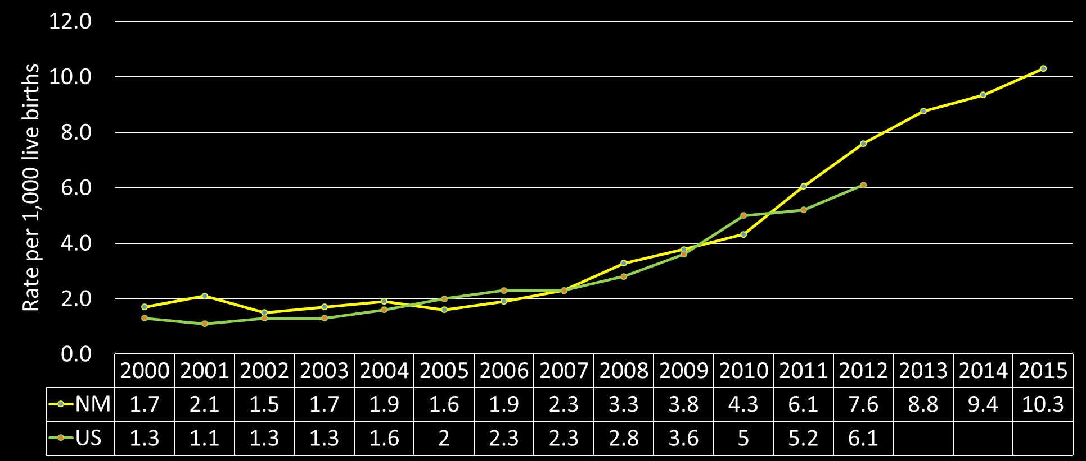
Neonatal Abstinence Syndrome,
NM (2000-2015) & US (2000-2012)
Sources: US: Weighted national estimates from HCUP Nationwide Inpatient Sample (NIS), 2000, Agency for Healthcare Research and Quality (AHRQ), based on data collected by individual States and provided to AHRQ by the States. Total number of weighted discharges in the U.S. based on HCUP NIS = 36,417,565.
New Mexico: 2000-2015 Hospital Inpatient Discharge Data (HIDD).

Slide 33
Naloxone

Slide 34
Instances* of Naloxone Distribution and Drug Overdose Reversals
 | 2016 |  | 2017 - First Half
 | Distributions | Reported Reversals^ | Distributions | Reported Reversals^
New Mexico | 4578 | 1728 | 818 | 351
Data Sources: NMDOH, BHSD-Southwest CARE Center Project, Medicaid
*Instances are defined as occasions on which a person got naloxone. These are not individual-level data as one person could have gotten naloxone more than once and from more than one of the sources used for this count. (Harm Reduction Data are as of August 11, 2017)
**Data do not reflect all instances of distribution due to late reporting as well as paid-out-of-pocket and private insurance naloxone coverage ^Reported Reversals are not necessarily individual level data, as one person could have overdosed and been reversed more than once

Slide 35
Instances* of Naloxone Distribution by County of Service (Distribution) and Average Drug Overdose Death Numbers by County of Residence (2016 & 2017 Instances)
County of Service (Distribution) | Instances of naloxone distribution in 2016 | Instances of naloxone distribution in 2017 (through June 2017) | Average number of drug overdose deaths per year, 2012-2016 | Ratio of naloxone(2017 through June)/deaths
Catron | 0 | 0 | 1 | 0.0
Cibola | 16 | 0 | 5 | 0.0
De Baca | 0 | 0 | 0 | 0.0
Guadalupe | 0 | 0 | 2 | 0.0
Harding | 0 | 0 | 0 | 0.0
Luna | 7 | 0 | 3 | 0.0
Mora | 4 | 0 | 1 | 0.0
Union | 0 | 0 | 0 | 0.0
Curry | 6 | 1 | 6 | 0.2
Torrance | 2 | 1 | 4 | 0.3
Sierra | 15 | 1 | 4 | 0.3
Grant | 10 | 4 | 8 | 0.5
San Juan | 22 | 11 | 21 | 0.5
Otero | 5 | 7 | 13 | 0.5
Lincoln | 19 | 4 | 7 | 0.6
Hidalgo | 2 | 1 | 2 | 0.6

Slide 36
Instances* of Naloxone Distribution by County of Service (Distribution) and Average Drug Overdose Death Numbers by County of Residence (2016 & 2017 Instances)
County of Service (Distribution) | Instances of naloxone distribution in 2016 | Instances of naloxone distribution in 2017 (through June 2017) | Average number of drug overdose deaths per year, 2012-2016 | Ratio of naloxone(2017 through June)/deaths
Rio Arriba | 202 | 31 | 32 | 1.0
McKinley | 81 | 15 | 9 | 1.7
Roosevelt | 1 | 6 | 3 | 2.0
Sandoval | 72 | 51 | 25 | 2.0
Valencia | 52 | 39 | 17 | 2.3
Dona Ana | 254 | 80 | 33 | 2.4
Eddy | 28 | 30 | 11 | 2.6
Lea | 200 | 16 | 5 | 3.2
Los Alamos | 11 | 9 | 3 | 3.5
New Mexico | 4578 | 1728 | 493 | 3.5
Taos | 67 | 38 | 10 | 3.9
Chaves | 39 | 46 | 12 | 3.9

Slide 37
Instances* of Naloxone Distribution by County of Service (Distribution) and Average Drug Overdose Death Numbers by County of Residence (2016 & 2017 Instances)
County of Service (Distribution) | Instances of naloxone distribution in 2016 | Instances of naloxone distribution in 2017 (through June 2017) | Average number of drug overdose deaths per year, 2012-2016 | Ratio of naloxone(2017 through June)/deaths
Colfax | 25 | 16 | 4 | 4.0
Quay | 7 | 10 | 2 | 4.2
Bernalillo | 1783 | 792 | 185 | 4.3
Socorro | 2 | 14 | 3 | 4.4
San Miguel | 123 | 48 | 11 | 4.4
Santa Fe | 1521 | 455 | 45 | 10.2
Data Sources: NMDOH-Harm Reduction Program, BHSD-Southwest CARE Center Project, Medicaid
*Instances are defined as occasions in which naloxone was provided to an individual. These are not individual-level data as one person could have gotten naloxone more than once and from more than one of the sources used for this count (data reported as of: June 2017)
**Data do not reflect all instances of distribution due to late/missing reports as well as purchases covered by private insurance or paid out of pocket.
***Harm reduction data as of 08/11/2017

Slide 38
Thank You
Contacts:
Annaliese Mayette
Annaliese.Mayette@state.nm.us
Ihsan Mahdi
Ihsan.mahdi@state.nm.us
Laura Tomedi
Laura.Tomedi@state.nm.us
NMDOH Substance Abuse Epi Website:
https://nmhealth.org/about/erd/ibeb/sap/
SA list serve contact:
Rosa Lopez
Rosa.Lopez@state.nm.us

